Slide 1
EzCARS - Car Rental
TEAM 1:
Tarjanee Desai - Project Manager
Harsh Patel - Product Owner
Charitha Gangaraju - Business Analyst
Bhavin Goswami - Lead Developer
Jitendra Rawat - Developer
Prithvi Karkera - QA Analyst
Avinash Bhavancheekar - Lead QA
Krupali Dangshiya - Software Tester
Shaik Sameera - Software Tester
Chandraharsha Kosuri - Software Tester
CS691_CRN73915 - Capstone Project

Slide 2
AGENDA
BRM Diagram
Context Diagram
RoadMap
RCT (main view only)
User Stories
UML Activity Diagram
ER Diagrams
Burndown Charts
Jenkins Progress Report
Live [Recorded] Application Demo

Slide 3
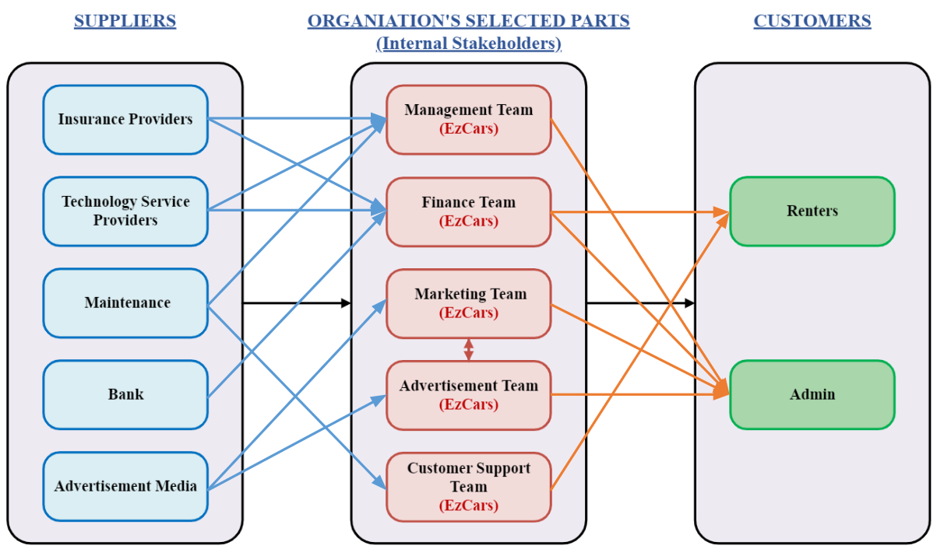
BRM DIAGRAM (Charitha Gangaraju)

Slide 4
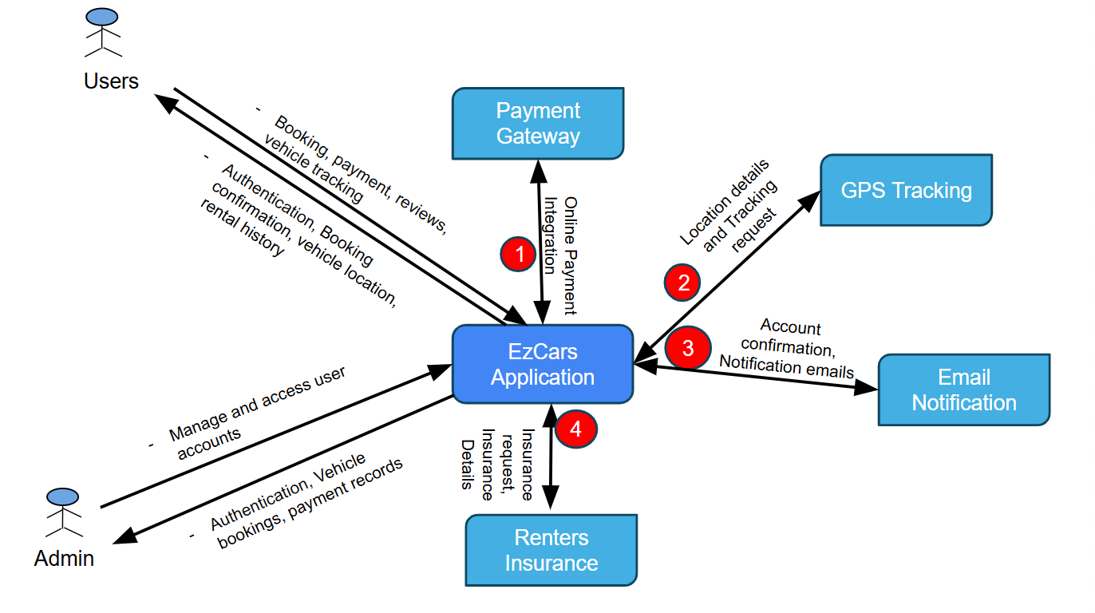
CONTEXT DIAGRAM (Prithvi Karkera)

Slide 5
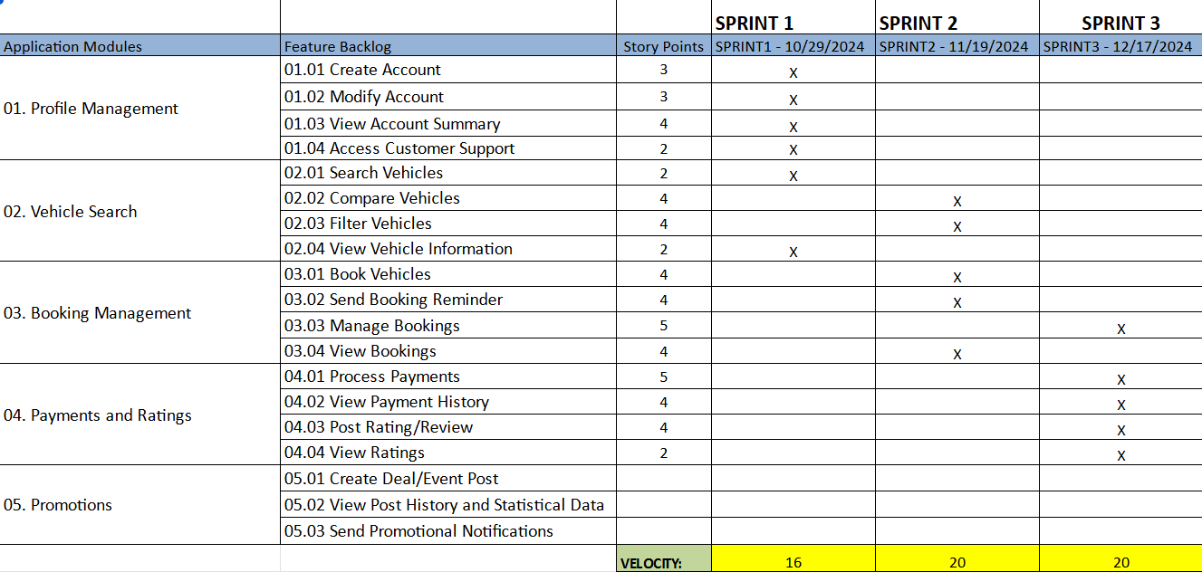
ROAD MAP (Sameera Shaikh)

Slide 6
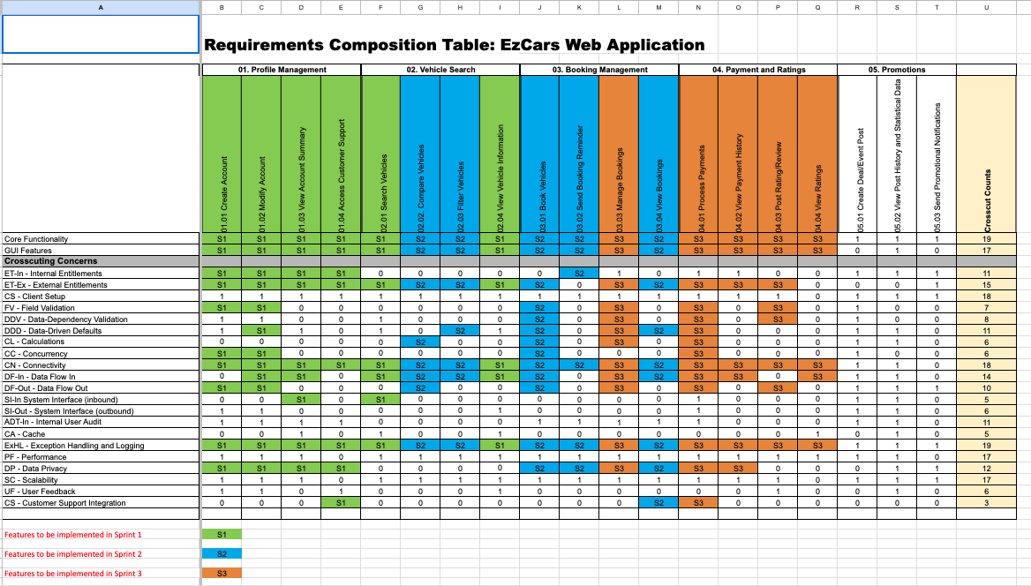
RCT: main view only (Avinash Bhavancheekar)

Slide 7
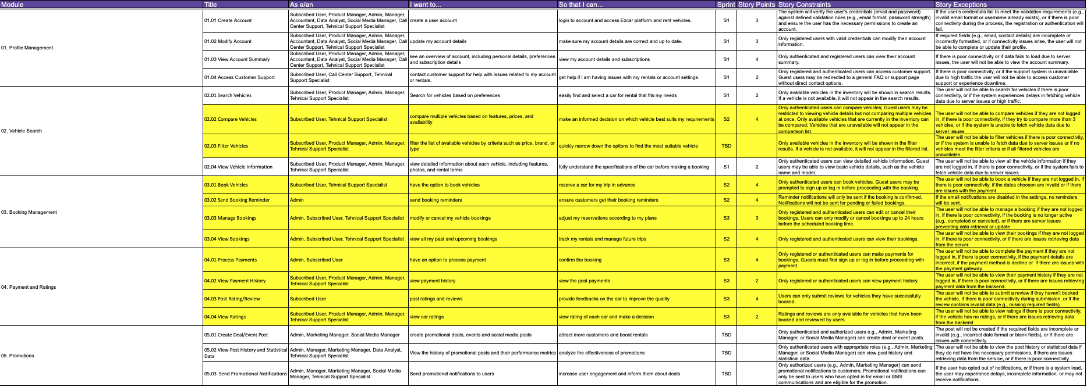
USER STORIES (Krupali Dangshiya)

Slide 8
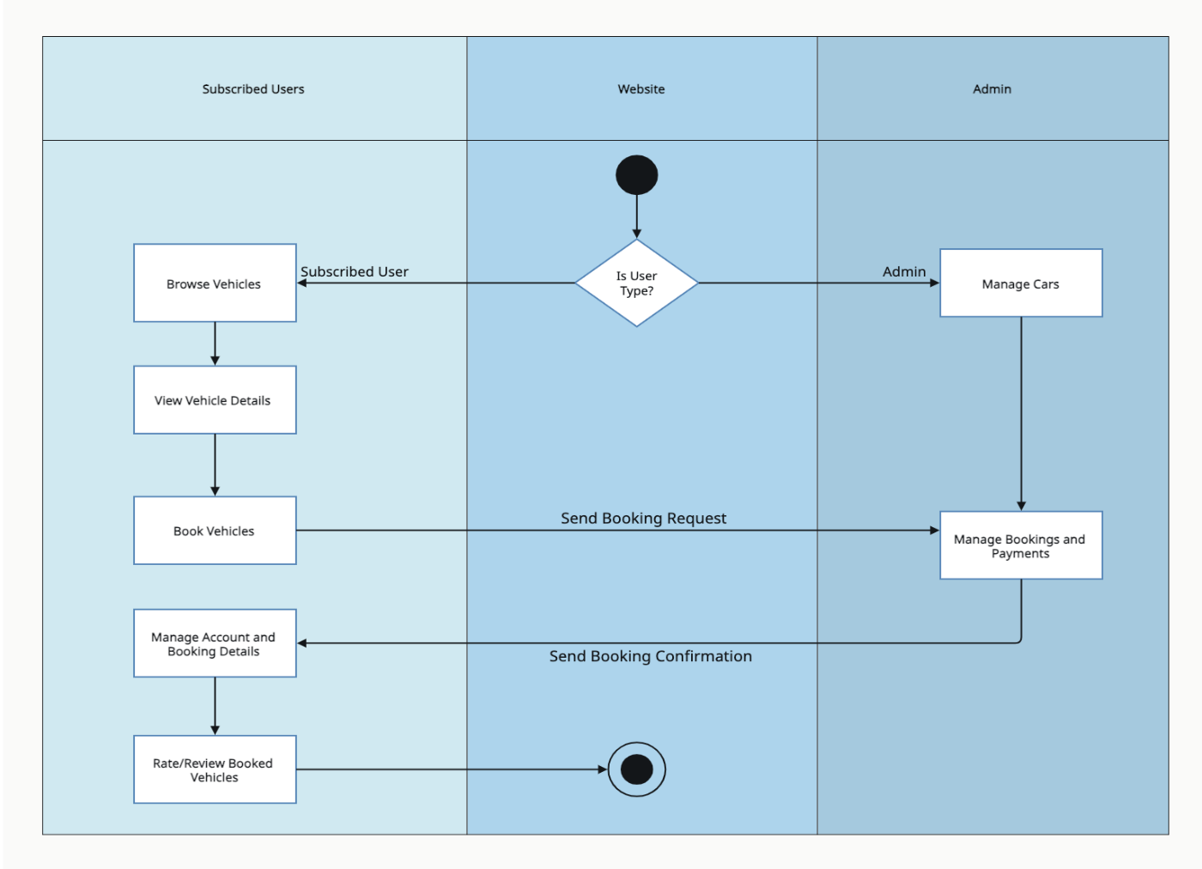
UML ACTIVITY DIAGRAM (Chandraharsha Kosuri)

Slide 9
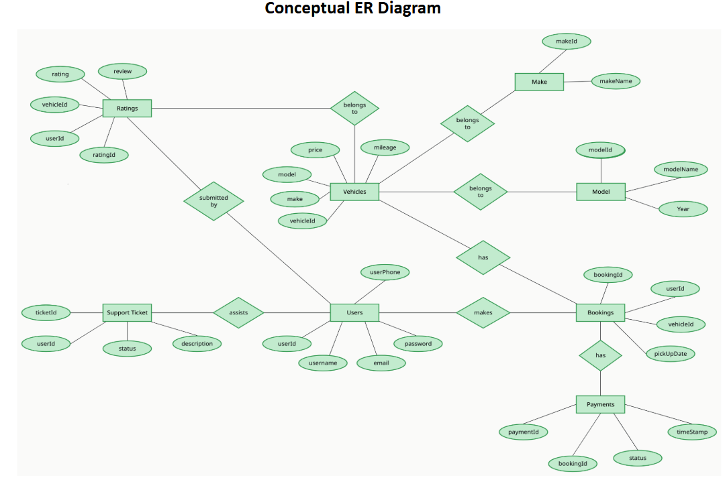
ER DIAGRAM (Harsh Patel)

Slide 10
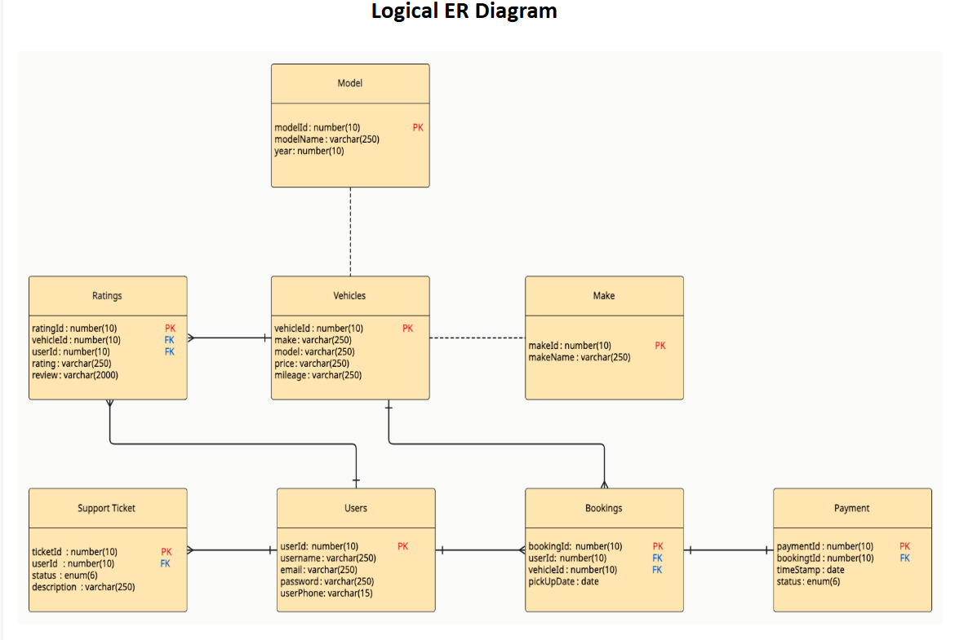
ER DIAGRAM (Harsh Patel)

Slide 11
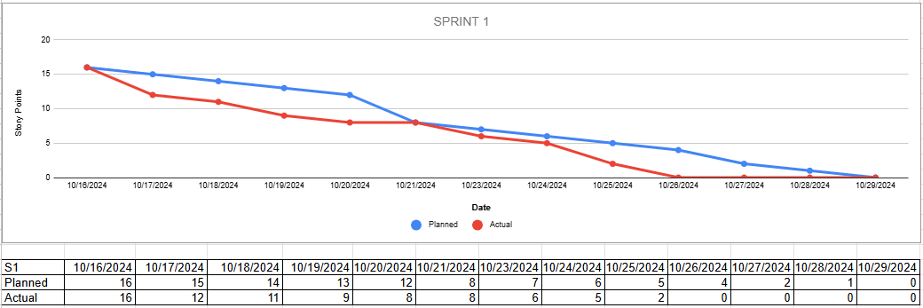
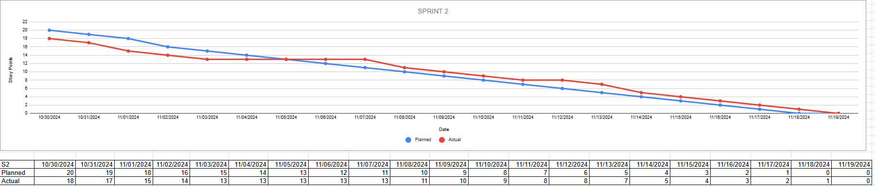
BURNDOWN CHARTS (Tarjanee Desai)
Sprint 1
Sprint 2

Slide 12
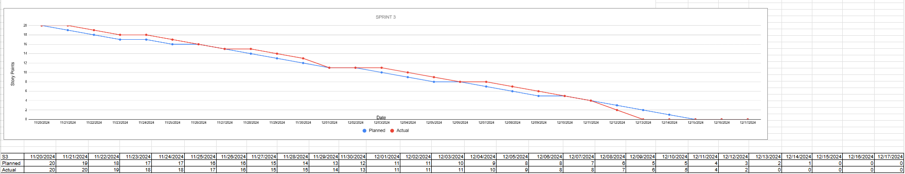
BURNDOWN CHARTS (Tarjanee Desai)
Sprint 3

Slide 13
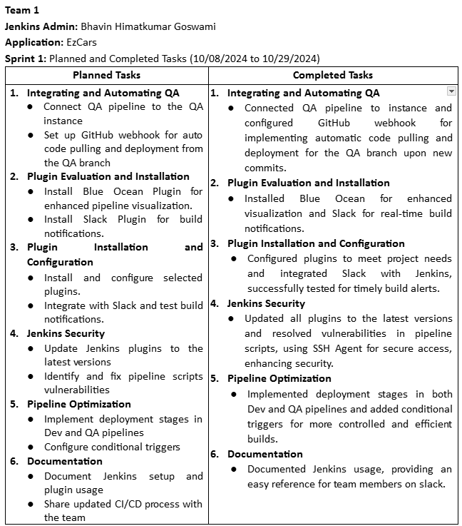
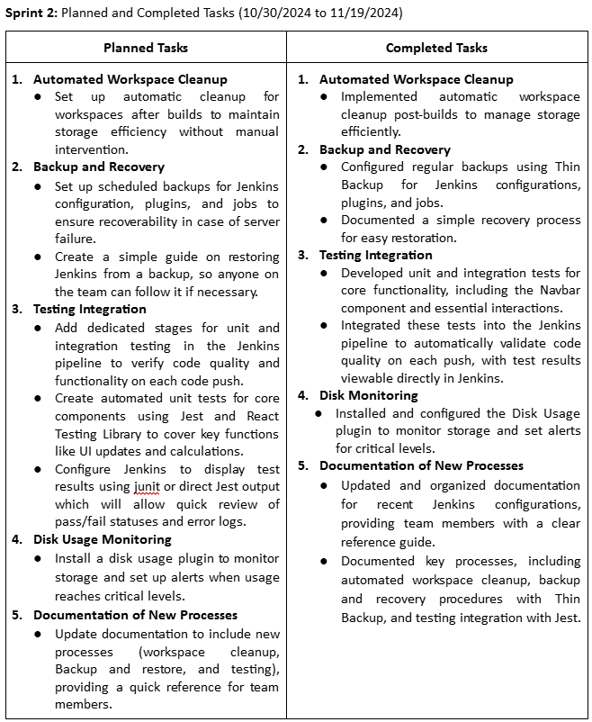
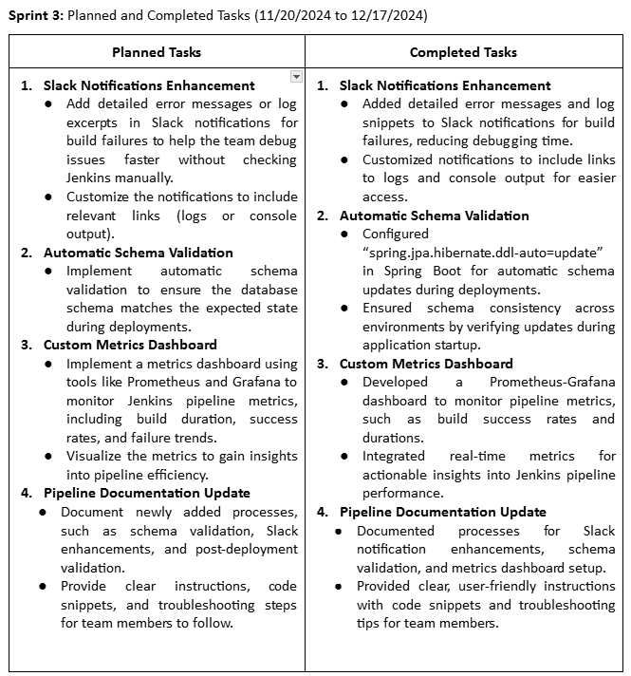
JENKINS PROGRESS REPORT (Bhavin Goswami)

Slide 14
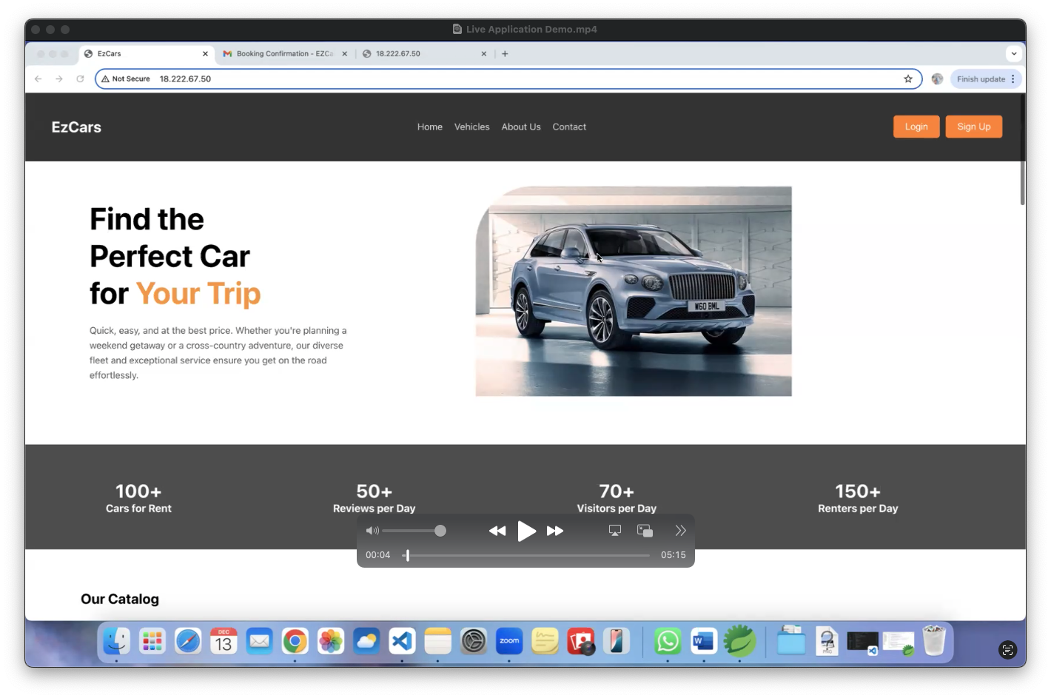
LIVE DEMO (Jitendra Rawat)

Slide 15
THANK YOU!

